Slide 1
Docker Basics

Slide 2
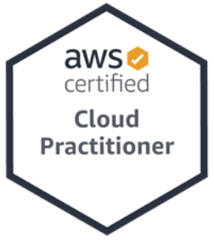
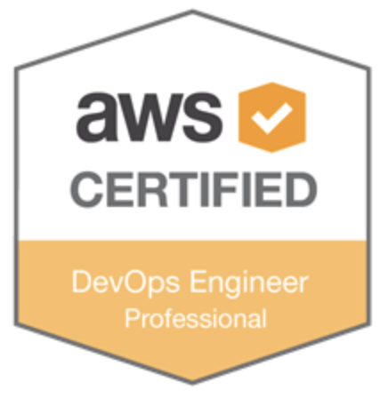
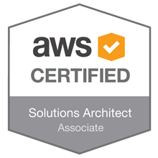
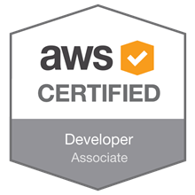
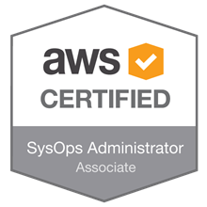
About me
Przemek Malak
AWS Architect Development at Chmurowisko Sp. z o.o.
19+ years in IT industry
Consultant, Architect and “Developer” for Amazon Web Services
Serverless enthusiast
Co-organizer AWS User Group PL (~3000 members)
devdiaries.pl

Slide 3
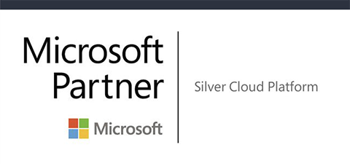

About US
We are a consulting and training company dedicated to the public cloud.
Our main goal is not only to promote cloud solutions but also to speed up the adoption of cloud worldwide.
We employ only the best experts in their fields, several of them acted as experienced Cloud Solution Architects.
Our core values:
Utter Responsibility
Constant development
Innovation
Openness
WOW effect

Slide 4
OUR SERVICES
WORKSHOPS
CONSULTING
IMPLEMENTATION
MEDIA
We provide clouds trainings at various levels. From basic, to advanced topics like IoT, A.I. migration.
We help building products, migrating, build a strategy for cloud implementation
We implement technology as a PoC, test or production environment.
We specialize in Amazon Web Services and Microsoft Azure.
We create entries, recordings, webinars, and online trainings to share as much cloud knowledge as possible through our channels.

Slide 5




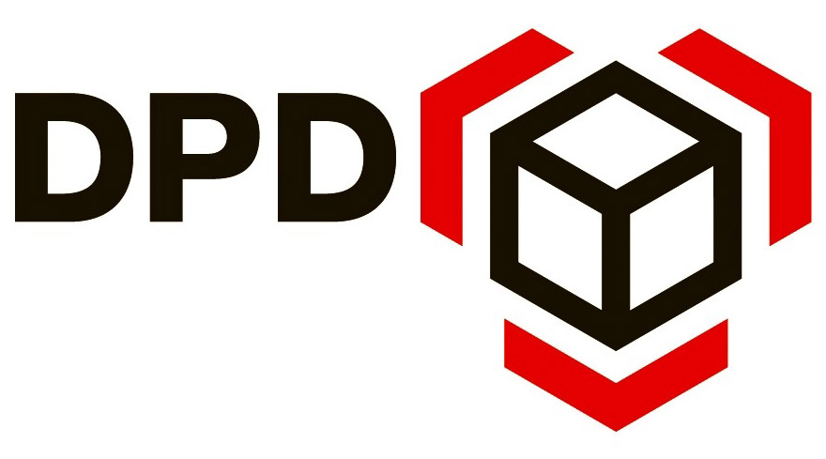

OUR CLIENTS
Training and implementation services
Training and implementation services
Training services
Training services
Implementation services
Training and implementation services

Slide 6
Azure Creds
studentX@mbankk8s.onmicrosoft.com
Testtest123!@#
D4 v3

Slide 7
Module Overview
History of Docker
Docker images
Dockerfile
Docker containers
Docker image repositories
Docker networking
Docker volumes

Slide 8
Why containers?
Before containers we needed to face some of these issues:
Dependenecies between applications
Dependencies from OS
Dependencies from hardware
Different deployment methods on different environments
Lack of isolation (versioning conflicts, DLL hell)
Same application behaves differently depending on the environment, OS, hardware, etc.
Notes:
W środowiskach, w których nie mamy żadnej izolacji pojawiają się pewno problemy:
Zależności aplikacji pomiędzy sobą, mogą pojawiać się konflikty w różnych wersjach bibliotek
Zalezności od systemu operacyjnego na którym uruchamiamy aplikacje
Zależności od sprzętu (np. od architektury procesora)
Tę samą aplikację wdrażało się inaczej w zależności od środowiska. Np. inaczej w datacenter, inaczej gdzieś u klienta, inaczej na środowisku testowym
Nie było izolacji aplikacji od otoczenia
Ta sama aplikacja mogła zachowywać się inaczej w zależności od środowiska, w którym była uruchamiana

Slide 9
How to resolve these issues?
We need isolation!
Benefits of isolation:
You can run same application on different OS, hardware
No versioning conflicts
Same abstraction for running app on differents environments
It doesn’t matter if you run the app in a cloud, in local datacenter or on a local machine

Slide 10
How can we achieve isolation?
Basically there are two ways to achieve isolation:
Virtual machines
Containers

Slide 11
Advantages of Containerisation
Forget about dependency nightmares
Consistent progression from DEV -> TEST -> QA -> PROD
Isolation - performance or stability issues of App A in container A, wont impact App B in container B.
Better resource management.
Extreme code portability
Microservices

Slide 12
Containers vs Virtual Machines
Why Containers?
Flexible: Even the most complex applications can be containerized.
Lightweight: Containers leverage and share the host kernel.
Interchangeable: You can deploy updates and upgrades on-the-fly.
Portable: You can build locally, deploy to the cloud, and run anywhere.
Scalable: You can increase and automatically distribute container replicas.
Stackable: You can stack services vertically and on-the-fly.
Notes:
Flexible: Even the most complex applications can be containerized.
Lightweight: Containers leverage and share the host kernel.
Interchangeable: You can deploy updates and upgrades on-the-fly.
Portable: You can build locally, deploy to the cloud, and run anywhere.
Scalable: You can increase and automatically distribute container replicas.
Stackable: You can stack services vertically and on-the-fly.

Slide 13
What did exists before containers?
Linux Chroot jail
Linux namespaces
Virtualization
Containers
Containers in Linux existed much earlier than Docker came into being
Notes:
Linux Chroot jail – zmiana katalogu root (/) systemu operacyjnego
Linux namespaces – dzięki temu możemy dzielić zasoby jądra linuxa pomiędzy kilka namespace’ów. Część zasobów (procesów, użytkowników, plików) może być uruchomiona w innym namespace
Wirtualizacja
Kontenery
Choć najczęściej używa się dockera do konteneryzacji, to konteneryzacja nie równa się Docker

Slide 14
Containers technologies
OpenVZ - 2005
LXC – 2008
Docker – 2013
Rkt - 2014
LXD – 2015
Windows Server Containers – 2016
And many others…
Notes:
OpenVZ -
LXC – Linux containers. Początkowo na tym bazował Docker
Rkt – Stworzony z myślą o środowiskach chmurowych, ta sama terminologia co w Kubernetesie
LXD – rozszerza LXC (łatwiejsza obsługa, jedno CLI, REST API, )
Windows Server Containers – może działać albo w trybie izolacji namespace’ów i procesów, albo w trybie Hyper-V (każdy kontener w osobnej maszynie wirtualnej)

Slide 15
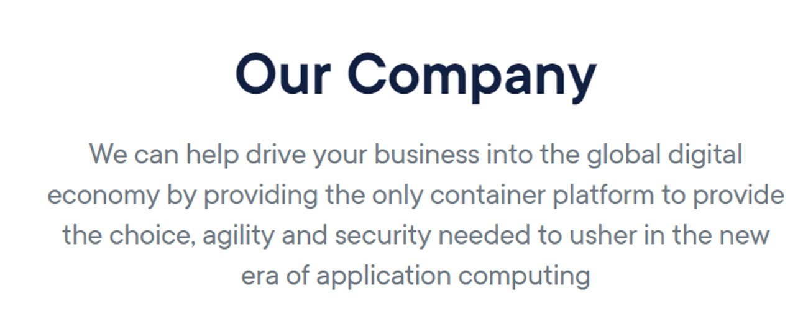
Introduction to Docker

Slide 16
Docker Editions
Community Edition (CE) – free and open source
Enterprise Edition (EE) - Premium version of Community Edition (3 pricing tiers) - ​
Docker EE comes with additional features:​
Certified Docker images​
Advanced image and container management​
Support from Docker Team​
Docker Datacenter​
Docker Security Scanning

Slide 17
Docker on Linux
Docker was using LXC (Linux Containers)​
Docker use the containerization features in the Linux kernel
Docker use Linux kernel to setup containers​
Containers run ON Linux, not Docker​
Any distribution running version 3.10 (released in 2013) ​or greater of the Linux kernel​
CentOS, Debian, Fedora, Ubuntu, Red Hat and ….​​

Slide 18
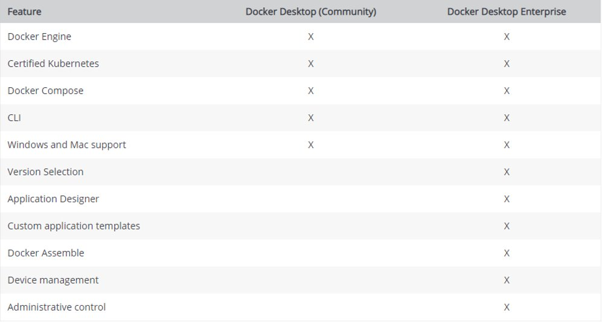
Docker Desktop
Application for MacOS and Windows​
Windows and Linux containers on Windows​
Enterprise and Community ​
Docker Toolbox (for older Mac and Windows)​

Slide 19
Docker Desktop for Windows
Available for free​
Native Windows application​
Run on Windows 10 and on Windows Server 2016​
Requires Windows 10 (x64) Pro​
Requires Hyper-V​

Slide 20

Docker Desktop for Mac
Available for free​
Native MacOS application​
Based on xhyve​
Only Linux containers​
Minimum OS version: MacOS Sierra 10.12​
Mac 2010 model or newer​

Slide 21
Containers vs Virtual Machines
Notes:
Każda maszyna wirtualna ma osobny system operacyjny, osobny zestaw bibliotek
W kontenerach bazowy OS jest wspólny
Kontenery mogą (choć nie muszą) współdzielić biblioteki

Slide 22
Introduction to containers
Why Docker and Containers?
Flexible: Even the most complex applications can be containerized.
Lightweight: Containers leverage and share the host kernel.
Interchangeable: You can deploy updates and upgrades on-the-fly.
Portable: You can build locally, deploy to the cloud, and run anywhere.
Scalable: You can increase and automatically distribute container replicas.
Stackable: You can stack services vertically and on-the-fly.
Notes:
Flexible: Even the most complex applications can be containerized.
Lightweight: Containers leverage and share the host kernel.
Interchangeable: You can deploy updates and upgrades on-the-fly.
Portable: You can build locally, deploy to the cloud, and run anywhere.
Scalable: You can increase and automatically distribute container replicas.
Stackable: You can stack services vertically and on-the-fly.

Slide 23
Docker components
Docker images
Docker container
Layers / Union file system
DockerFile
Docker Engine
Docker Client
Docker registries / Docker hub

Slide 24
Docker image
Docker containers are based on Docker images. ​
A Docker image is a binary that includes all of the requirements for running a single Docker container, as well as metadata describing its needs and capabilities. ​
Docker containers only have access to resources defined in the image, unless you give the container additional access when creating it. ​
Docker images are defined using Dockerfiles

Slide 25
Docker CLI
Command line interface for Docker​
Client for running Docker Engine to create images and containers​
Installed with Docker Engine​
https://github.com/docker/cli​

Slide 26
Dockerfile
Describe the way to build your container​
Imperative ​
Instruction how to create your Image/Container​
Plain Text​

Slide 27
Dockerfile
FROM ubuntu:14.04​
​
RUN echo "Hello world" > /test/hello_world.txt​
​
CMD ["cat", "/test/hello_world.txt"]​
​
​

Slide 28
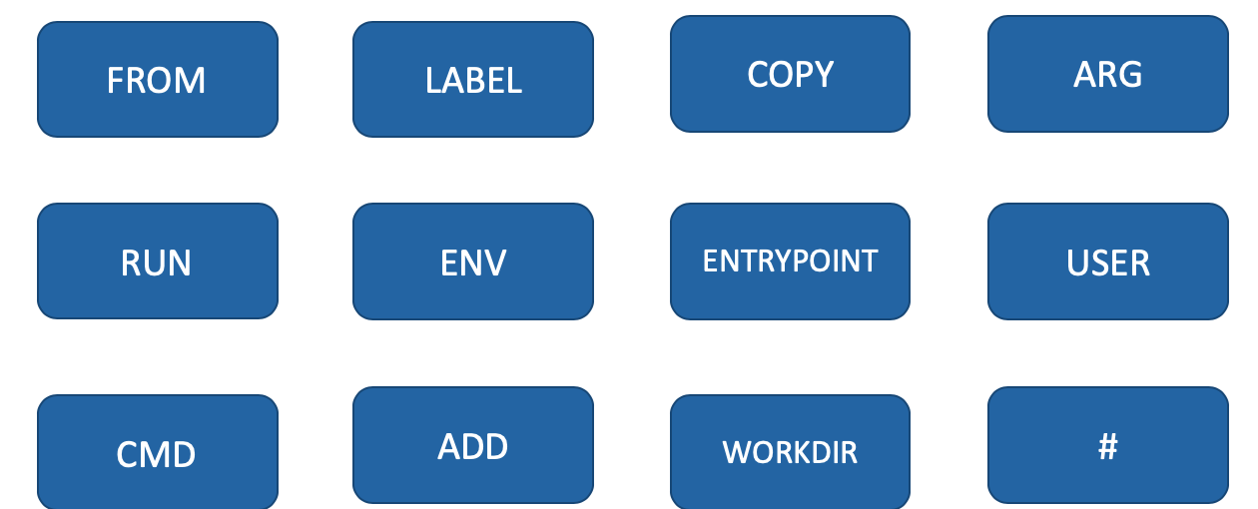
Dockerfile commands

Slide 29
Dockerfile - multistage
Multiple „FROM”​
Copy artifacts from one stage to another​
Reduce size of your final image ​
FROM ubuntu:14.04 as Build-Stage
...
...
...
RUN [”build”, ”app”]
FROM ubuntu:18.04
...
...
...
RUN [”run”, ”app”]

Slide 30
Dockerfile – best practice
Reduce the dockerfile image layers
Image build latency is affected by the specific dockerfile architecture attributes, especially, number of image layers, size of each layer, and the diversity of instructions
Choose wisely your Base Image [FROM]
Mulit Stage Dockerfile
Read „Best practices for writing Dockerfiles”

Slide 31
Dockerfile and Docker image
DockerFile
Docker Image
FROM microsoft/aspnetcore:latest
ENV ASPNETCORE_URLS http://+:5103
EXPOSE 5103
COPY obj/Docker/publish .
ENTRYPOINT ["dotnet", "dotnetcoredocker.dll"]
91e54dbfb1179
280 MB
d74508f6632fd
300 KB
c22013c84729
100.5 KB
a02ee41c795f
254 B
5614e355542
0 B
Thin R/W Layer

Slide 32
Docker container
Docker containers are building blocks for applications.
Each container is an image with a readable/writeable layer on top of a bunch of read-only layers.
Docker Image
91e54dbfb1179
280 MB
d74508f6632fd
300 KB
c22013c84729
100.5 KB
a02ee41c795f
254 B
5614e355542
0 B
Container 1 Thin R/W Layer
Container 2 Thin R/W Layer
Container 3 Thin R/W Layer

Slide 34
Docker build
Build an image from a Dockerfile and a „context”
„Context” is a set of files located in a specific PATH or URL
docker build . // build an image with Dockerfile and context in current directory
​docker build –f Dockerfile.test // use Dockerfile.test instead
docker build –t myimage . // tag an image
docker build github.com/creack/docker-firefox // clone git repo and use it as a context
​

Slide 35
Docker run
Runs proces in isolated container
Must specify an image
Image can be local or from remote repository (DockerHub by default)
Container can be run in detached mode (background) or in foreground mode
docker images // list all local images
​docker run mylocalimage// run mylocalimage in foreground mode
docker run –d mylocalimage // run mylocalimage in background mode
docker run –it ubuntu // -t – allocate a pseudo tty, -i – keep STDIN open
docker run –rm myserver // remove container after it exits
docker run –p 80:80 myserver // map local port 80 to container’s port 80
docker run ubuntu whoami // run ubuntu image and execut „whoami” command
docker run –it myserver bash // runs container myserver and executes bash

Slide 36
Docker registry
Stateless, highly scalable server side application that stores and lets you distribute Docker image
Use cases:
tightly control where your images are being stored
fully own your images distribution pipeline
integrate image storage and distribution tightly into your in-house development workflow
Images in registry can be public or private (requires authentication)
DockerHub – free to use, hosted Docker Registry.
docker run chmurowiskoregistry.azurecr.io/hello-world // run image from registry
​docker pull chmurowiskoregistry.azurecr.io/hello-world // pull container from registry and cache on local machine
docker tag ubuntu chmurowiskoregistry.azurecr.io/ubuntu // tag an image so it points to your registry
docker push chmurowiskoregistry.azurecr.io/ubuntu // push an image to your registry

Slide 37
Docker networking
Docker can run in multiple network nodes using drivers:
Bridge
Host
Overlay
Macvlan
None
You can set up network driver using „--network” parameter for „docker run”

Slide 38
Docker networking – bridge driver
default
creates private network between host and container.
Multiple containers can communicate with each other.
External access is done by exposing ports

Slide 39
Docker networking – host driver
No network isolation between host and container
Host and container share same network namesapce
Container running on port 80 will be available on host’s port 80
Doesn’t work on Docker Desktop, so only work on Linux

Slide 40
Docker networking – overlay driver
Used in multi-host environment
Creates distributed network among multiple Docker hosts
Handles routing automatically

Slide 41
Docker networking – macvlan
Assign a MAC address to a container
Container apperas as a physical device on network
Traffic is routed to containers by using MAC address
Useful for legacy applications that expect to be directly connect to network

Slide 42
Docker bind mounts and volumes
Mounts and volumes are used to persist data generated by and used by container
Mount – a file or directory on the host machine is mounted into a container
Volume – object managed by Docker, lives independently of a container
Tmpfs mount – for temporary data
You can use –v parameter (shortest) or --mount (more verbose)

Slide 43
Bind mount
File or directory on a host machine doesn’t need to exists
Relies on the host machine’s filesystem
They are not managed by Docker
Mounted directories overwrites container’s directories
docker run -d -it -v "$(pwd)"/target:/app nginx:latest // mounts local ‘target’ directory on container’s ‘app’ directory
​docker run -d -it --mount type=bind,source="$(pwd)"/target,target=/app nginx:latest // same result as above
docker run -d -it -v "$(pwd)"/target:/app:ro nginx:latest // creates a read-only mount

Slide 44
Volumes
Volumes are preferred mechanism for persisting data
Independent from host machine’s filesystem
Manager by Docker:
Using CLI you can view, create and delete volumes
Easier to share between containers
Easier to backup or migrate
Volumes can be stored on remote hosts or cloud providers
docker volume create myvolume// create volume ‘myvolume’
​docker volume ls // list volumes
docker volume inspect myvolume // inspect the volume
docker volume rm myvolume // remove the volume
docker run -d --mount source=myvolume,target=/app nginx:latest // mount ‘myvolume’ as ‘/app’ directory
docker run -d -v myvolume:/app nginx:latest // same as above

Slide 45
Summary
Isolation is important while running multiple apps in the same environment
Containers are more lightweight and flexible than Virtual Machines
Docker is not the only contenerization technology
Docker is available in two editions: CE and EE​
We should use Docker Desktop for Mac and Windows​
On Linux we need to install Docker Engine​

Slide 46
http://bit.ly/mbank-k8s2

